Slide 1
Impact of Load Balancing on Parallel Performance with Haar Wavelets Angular Adaptivity
Ioannis Nikiteas, Steven Dargaville , Richard P. Smedley-Stevenson, Paul N. Smith, Chris C. Pain

Slide 2
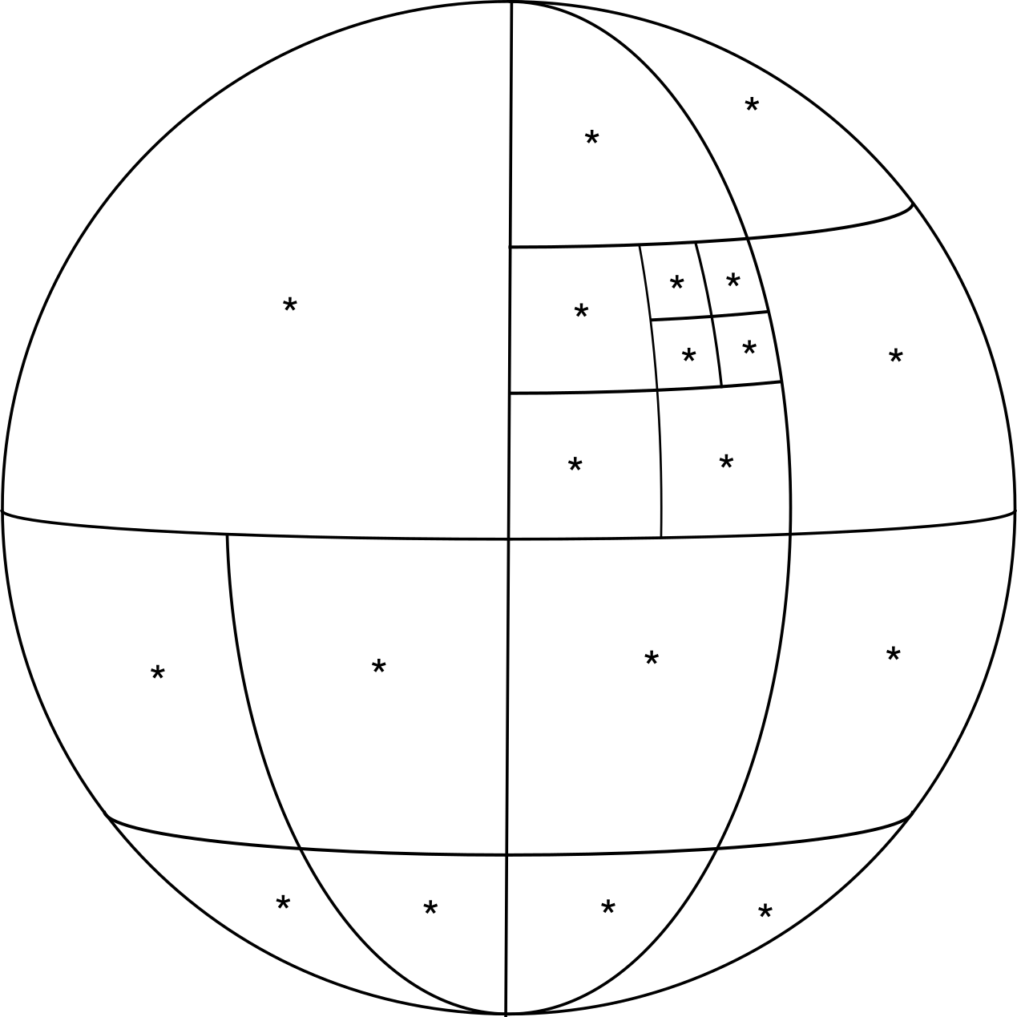
Adaptive refinement (angular domain)
FETCH2 is a Deterministic Finite Element code on unstructured grids developed by AMCG in Imperial College London.
Globally fine meshes can result in slow simulations.
Adaptivity performs localised refinement/coarsening in areas of “interest”.
We use a Haar wavelet angular discretisation structured to be equivalent to a P0-DGFEM
Notes:
How accurate this model is depends on how fine the mesh is.
Using an very fine mesh for the entire problem would cripple the runtime performance of any code,
Hence we use local refinement on our meshes in areas of “interest” to get more accurate solutions, leaving the rest of the meshes intact.

Slide 3
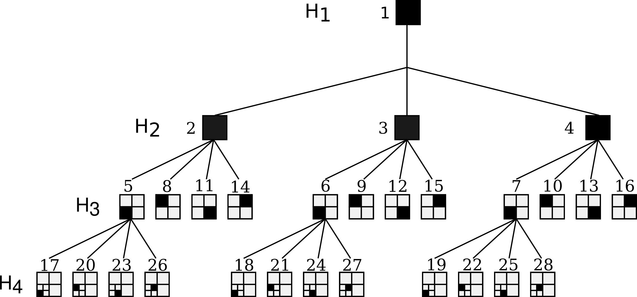
Haar wavelet angular discretisation
Haar wavelets are hierarchical with compact support.
Based on norm-equivalence and cancelation properties:
norm-equivalence: small coefficients have a small contribution to the approximated norm
cancellation properties: over smooth regions of support coefficients are smooth
Regular adaptivity error metric by thresholding.
Notes:
Since this is a deterministic code we use meshes to model radiation.
How accurate this model is depends on how fine the mesh is.
Using an very fine mesh for the entire problem would cripple the runtime performance of any code,
Hence we use local refinement on our meshes in areas of “interest” to get more accurate solutions, leaving the rest of the meshes intact.
TODO: change error metric to a tri-curly bracket
TODO: Put sphere on quad-tree $ϵ ≈e= {\left|ψ\right|}/t$

Slide 4
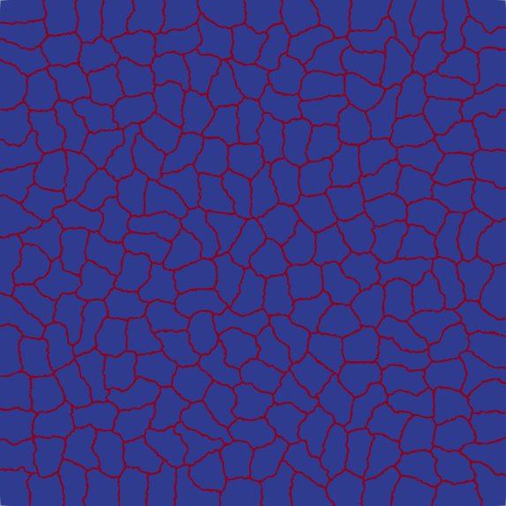
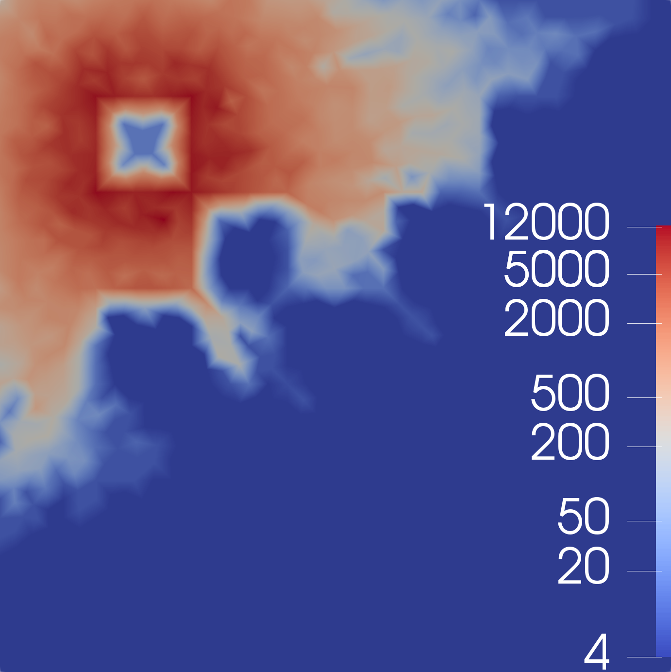
Dynamic Load Balancing (DLB)
Adaptivity causes imbalances in the computational domain.
DLB attempts to minimise the imbalances by performing a domain decompositions.
Domain Decomposition
Number of wavelets (angles)
Notes:
Since this is a deterministic code we use meshes to model radiation.
How accurate this model is depends on how fine the mesh is.
Using an very fine mesh for the entire problem would cripple the runtime performance of any code,
Hence we use local refinement on our meshes in areas of “interest” to get more accurate solutions, leaving the rest of the meshes intact.
TODO: DD caption && Number of wavelets

Slide 5
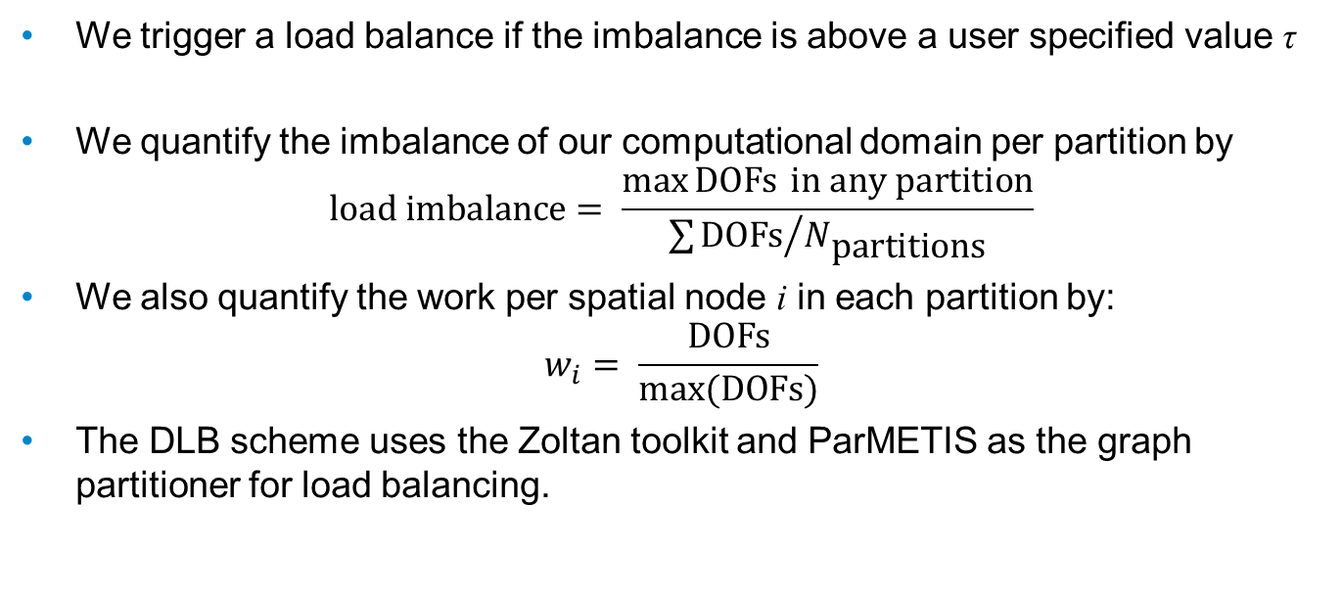
Dynamic Load Balancing (DLB)
We trigger a load balance if the imbalance is above a user specified value τ
We quantify the imbalance of our computational domain per partition by $\text{load} \text{imbalance}= \frac{\text{max}{\text{DOFs}} \text{in} \text{any} \text{partition}}{{\sum{\text{DOFs}}}/{N_{\text{partitions}}}}$
We also quantify the work per spatial node i in each partition by: $w_{i}= \frac{\text{DOFs}}{max⁡(\text{DOFs})}$
The DLB scheme uses the Zoltan toolkit and ParMETIS as the graph partitioner for load balancing.
Notes:
TODO: <DOFs> Sum DOFs/N partitions which is the average. You can pick the minimum but you have to be careful to not have 0 partitions
For these discretisation the amount of work is proportional to the NDOFs in the partition, hence it’s a good estimate (all that works because we are order n)
NOTE: if needed add compress algorithm after here

Slide 6
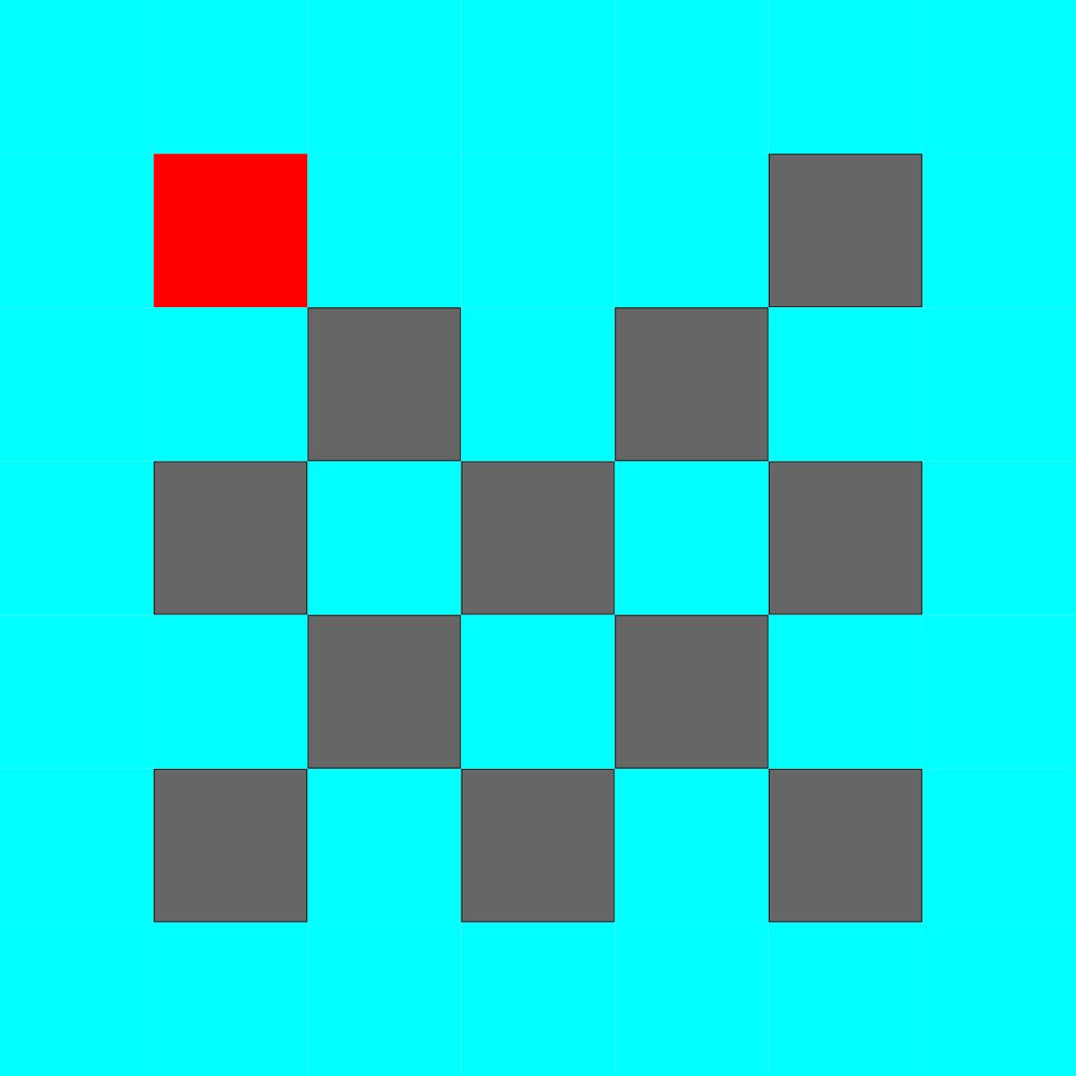
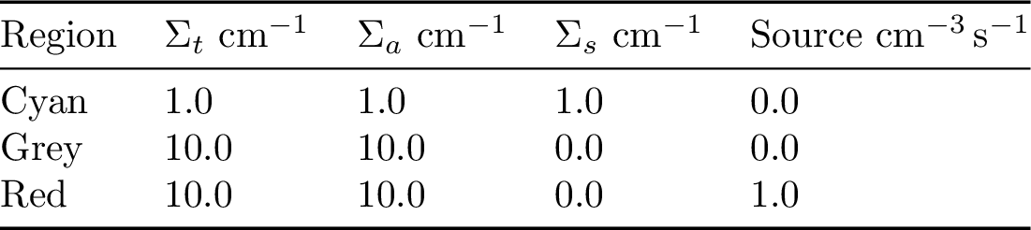
Brunner lattice
1.06 million triangular elements
Initial angular discretisation 4 wavelets 15 million DOFs is the initial problem size.
Run on ARCHER (Cray XC30)
1 node (24 cores per node).
Notes:
The problem consists of a source (red), a transparent medium (white) and an absorber (grey) with their respective total cross sections being 0.5, 0.005 and 0.5 cm⁻¹ and the source also having a fission cross section of 1 cm⁻³s⁻¹.
This problem features highly anisotropic flux and heavy particle streaming through the duct regions.
The problem was simulated by using a mesh with 500k triangular elements and 1.1M CDOFs at adapt 0
This is a small run
We expect to see the adaptivity heavily adapting around the source, given that we use regular adaptivity, because that is where things are big and also at regions where things are discontinuous in space-angle

Slide 7
Notes:
This example showcases how angular adaptivity works on a spatial mesh.
TODO: after this add table with total DOFs vs adapt

Slide 8
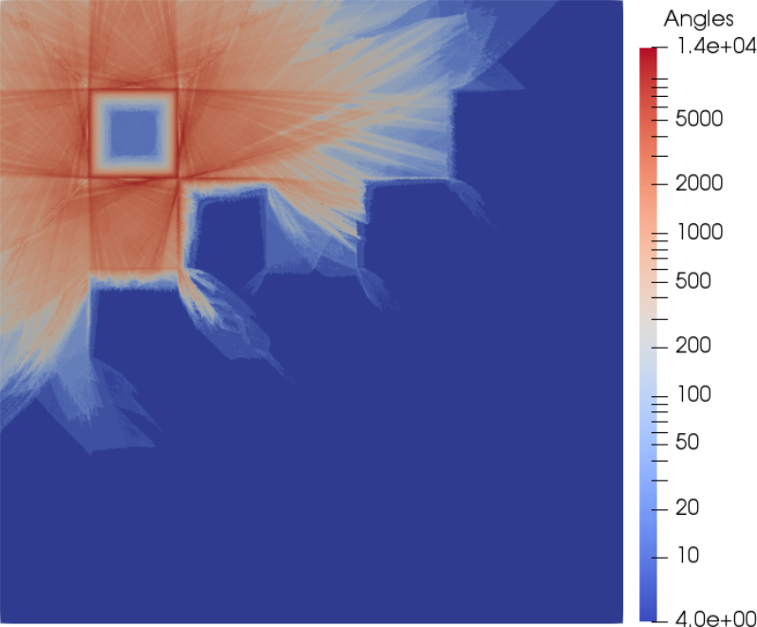
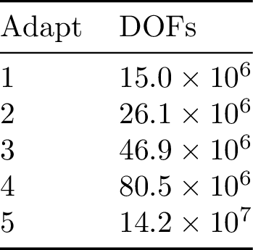
Brunner lattice post adapt

Slide 9
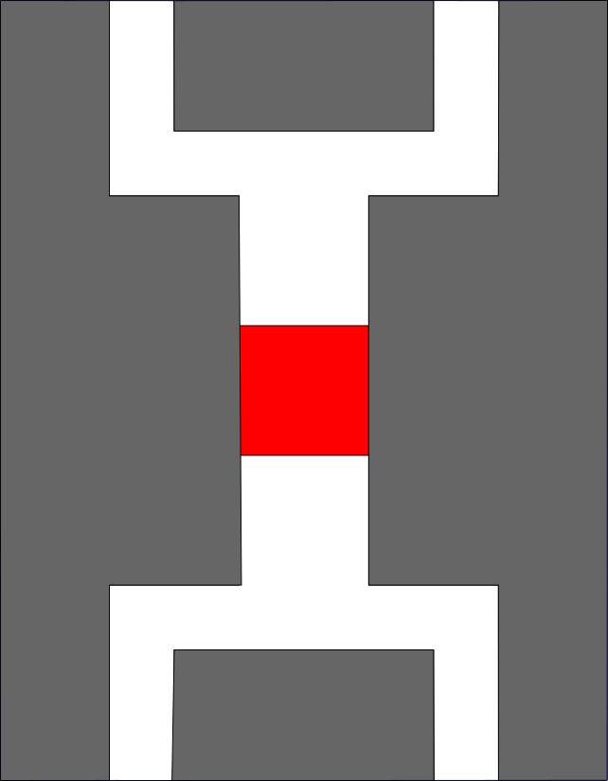
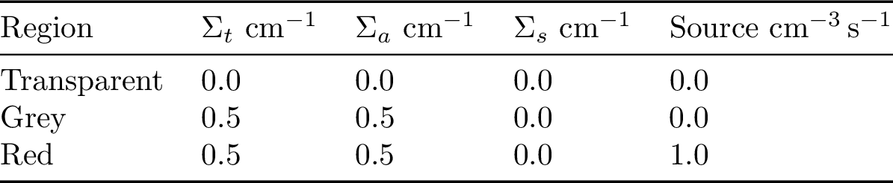
Dogleg shielding problem
1.06 million triangular elements corresponding to 14.9 million DOFs is the initial problem size.
Notes:
TODO: maybe add a table of how the CDOFs grow per adapt

Slide 10
Notes:
In our problem this is what adaptivity does,

Slide 11
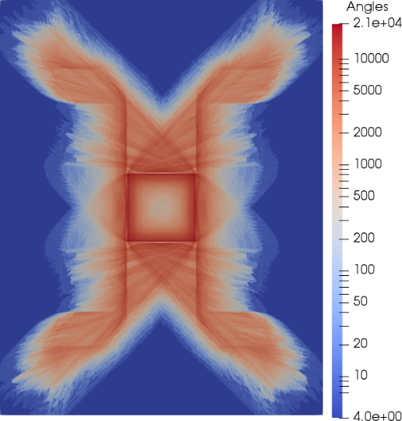
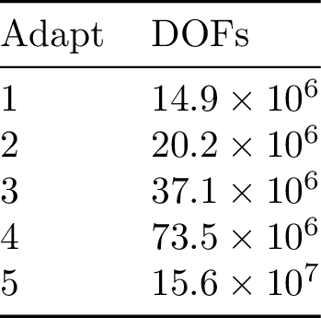
Dogleg problem post adapt

Slide 12
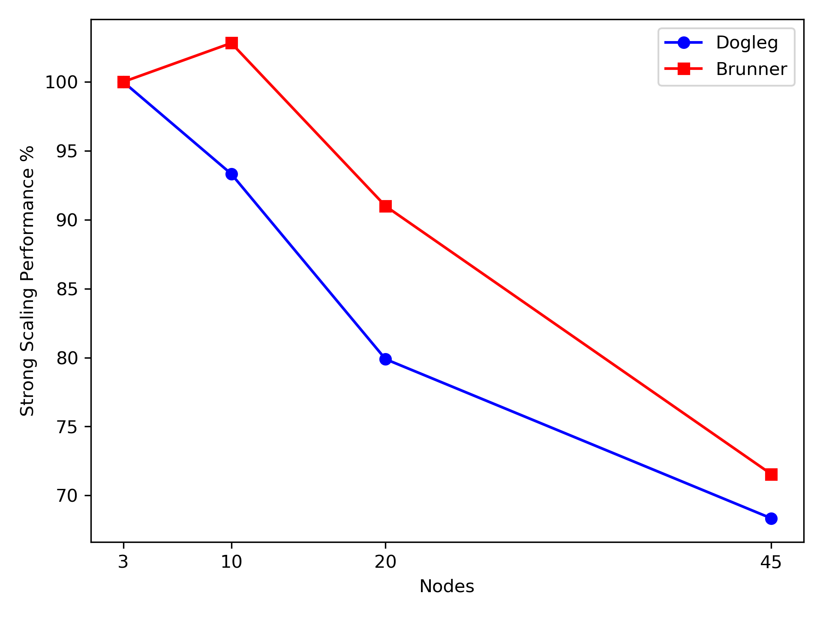
Strong scaling study
We perform angular adaptivity with load balancing enabled.
Our strong scaling performance decreases when we increase the number of processors
This is either caused by:
The load balancing algorithm
The mat-vecs of the iterative method
Notes:
TODO: change to nodes
TODO: change iterative method to matvecs of the iterative method!!!!! We don’t use a sweep

Slide 13
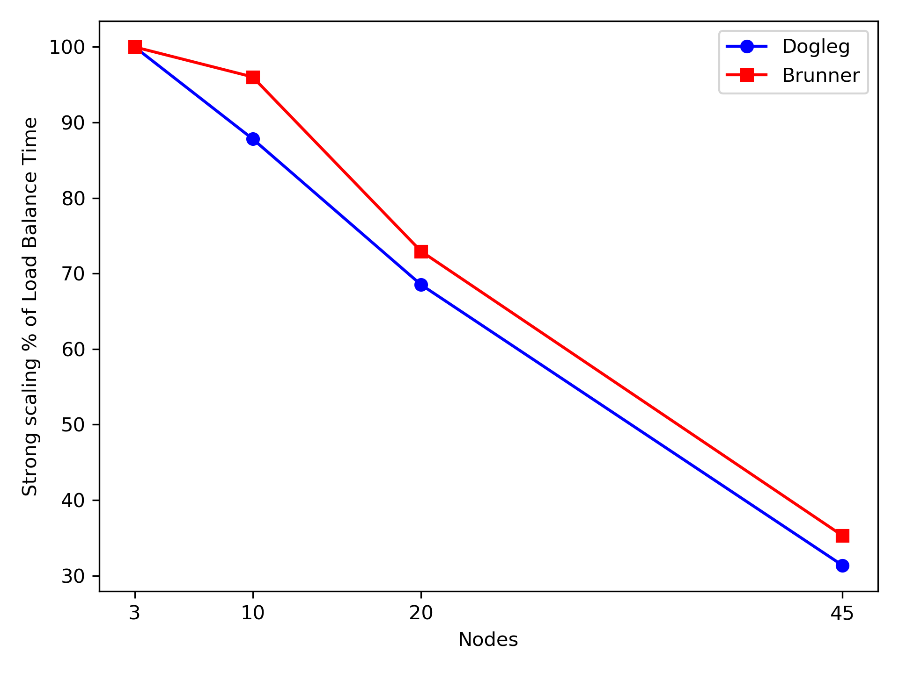
Strong scaling study
We perform angular adaptivity with load balancing enabled.
Our strong scaling performance decreases when we increase the number of processors
This is either caused by:
The load balancing algorithm
The mat-vecs of the iterative method
Notes:
TODO: the plot here is lb time strong scaling perf
TODO: do a strong scaling performance of the load balance time plot.
This is not necessarily good, but the amount of time is substantially as in smaller than the solve times, which are in the order of minutes. So not a big issue or the origin of our problems,.
TODO: pass changes from previous slide in text here too

Slide 14
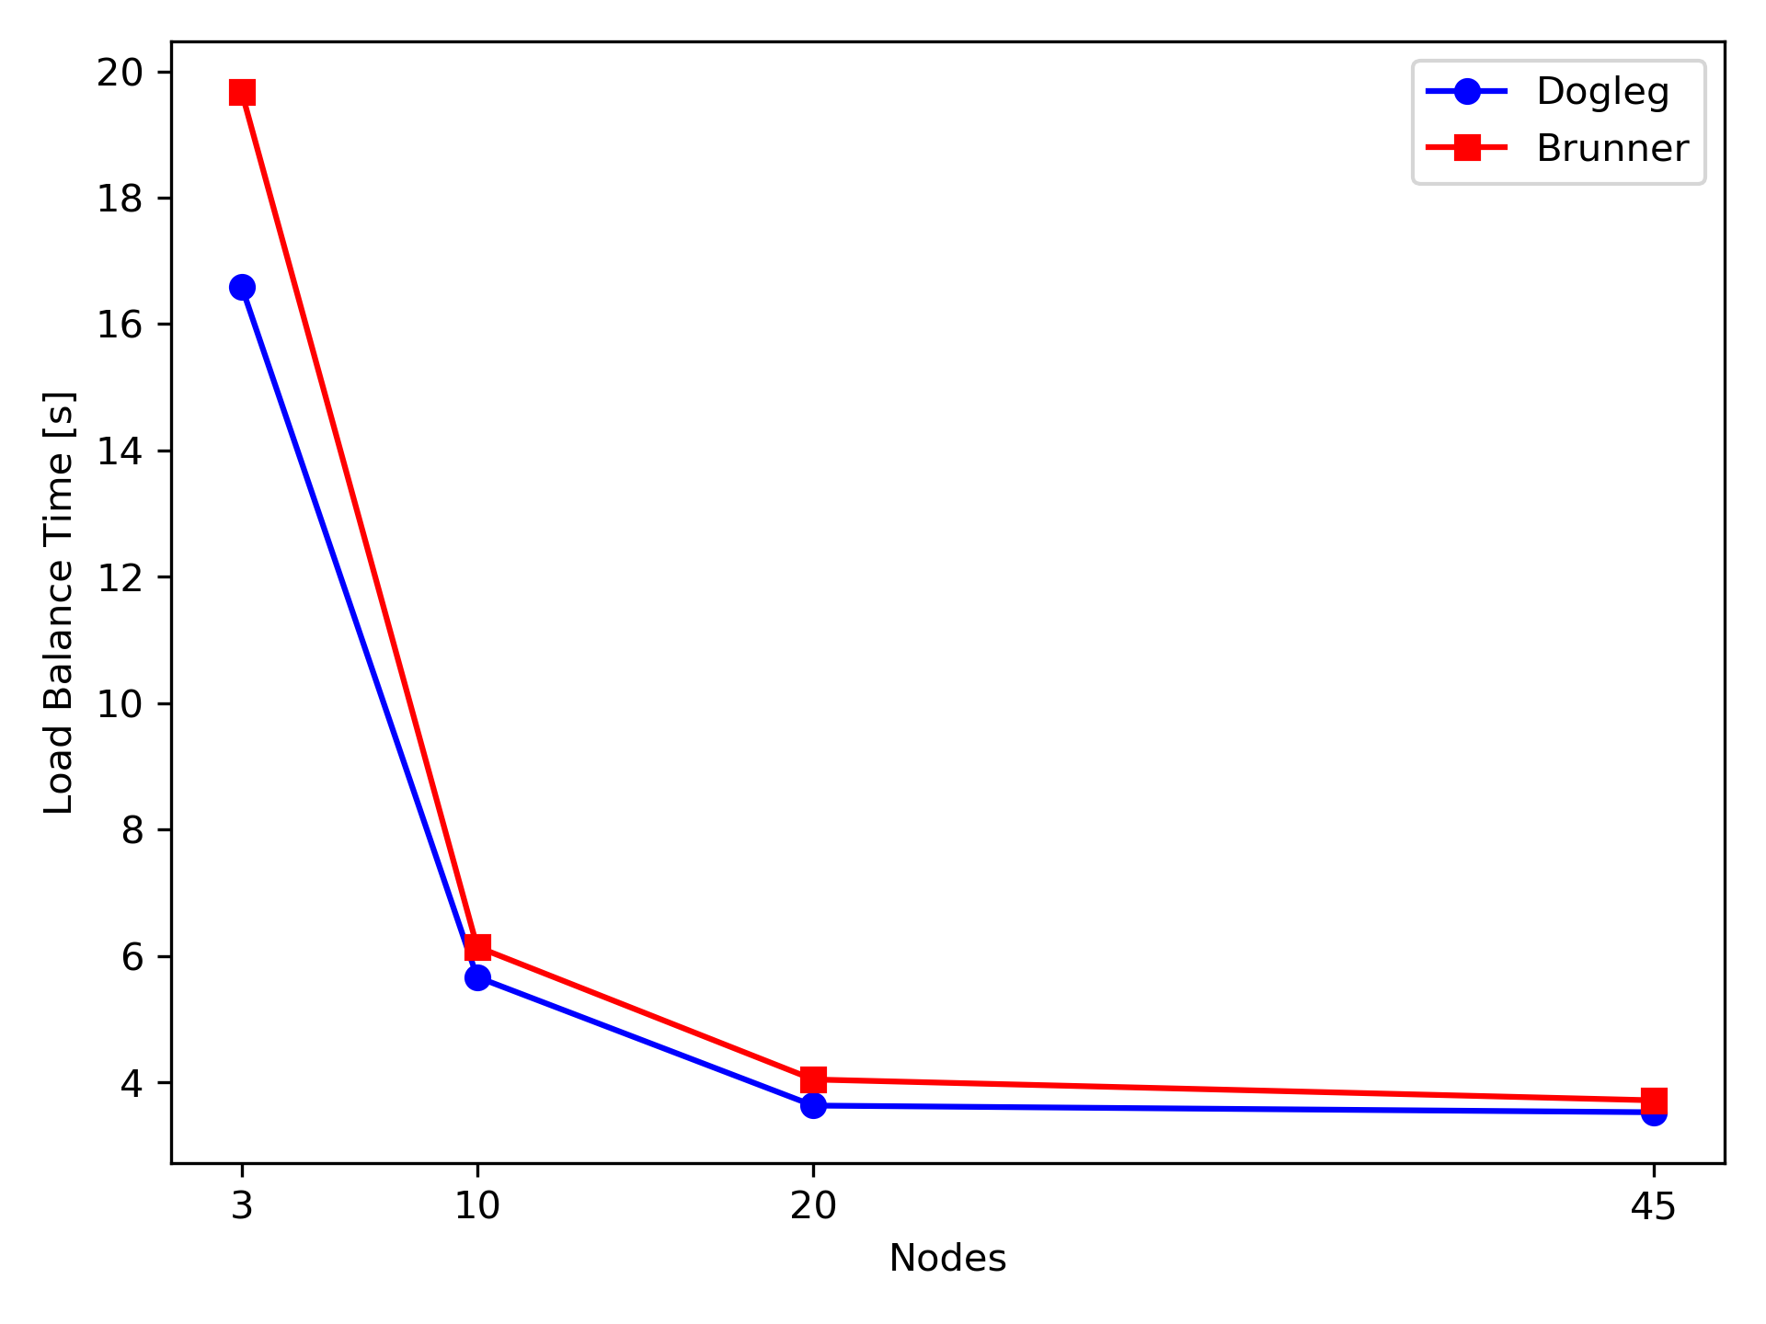
Strong scaling study
We perform angular adaptivity with load balancing enabled.
Our strong scaling performance decreases when we increase the number of processors
This is either caused by:
The load balancing algorithm
The mat-vecs of the iterative method

Slide 15
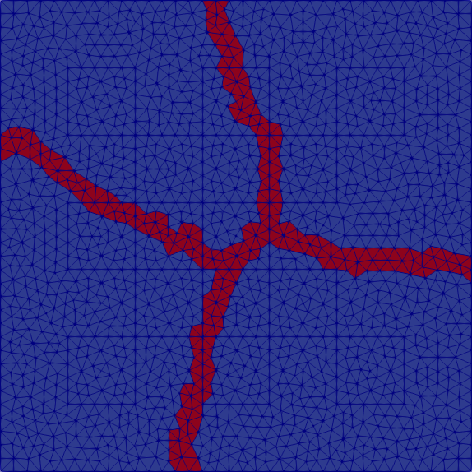
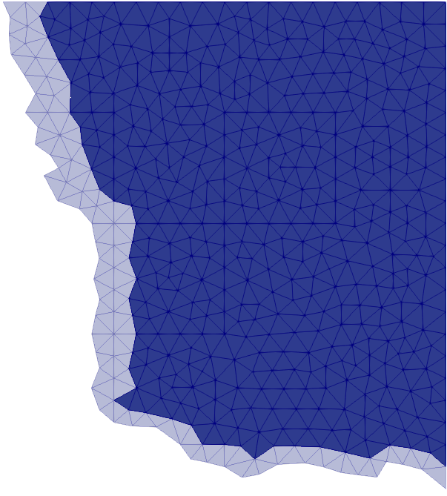
Partitions and Halos
Notes:
Halos are copy nodes of the neighbouring partitions, which allow us to perform the mat-vecs on the boundary nodes of the partitions.
Halos require communication between the neighbouring partitions and communications are costly in large computers e.g. ARCHER UK’s supercomputer.
But as long as the number of halo nodes in a partition remains relatively small compared to the number of nodes it contains then the
Halos are used a lot because they decrease the number of coms to be done by saving a copy of neighbouring nodes
Partition will have enough computational work to perform when compared to the communication costs that are introduced from the halos.
DO one set of coms instead of 2.

Slide 16
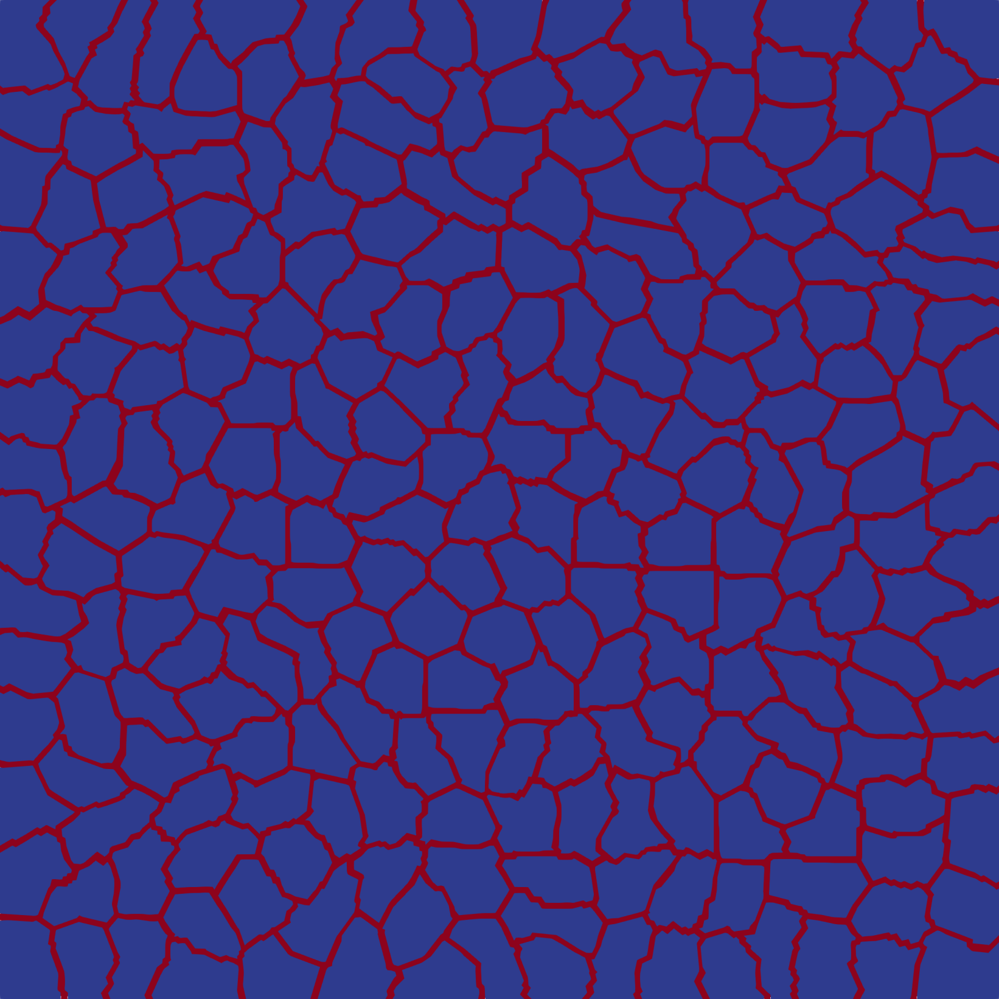
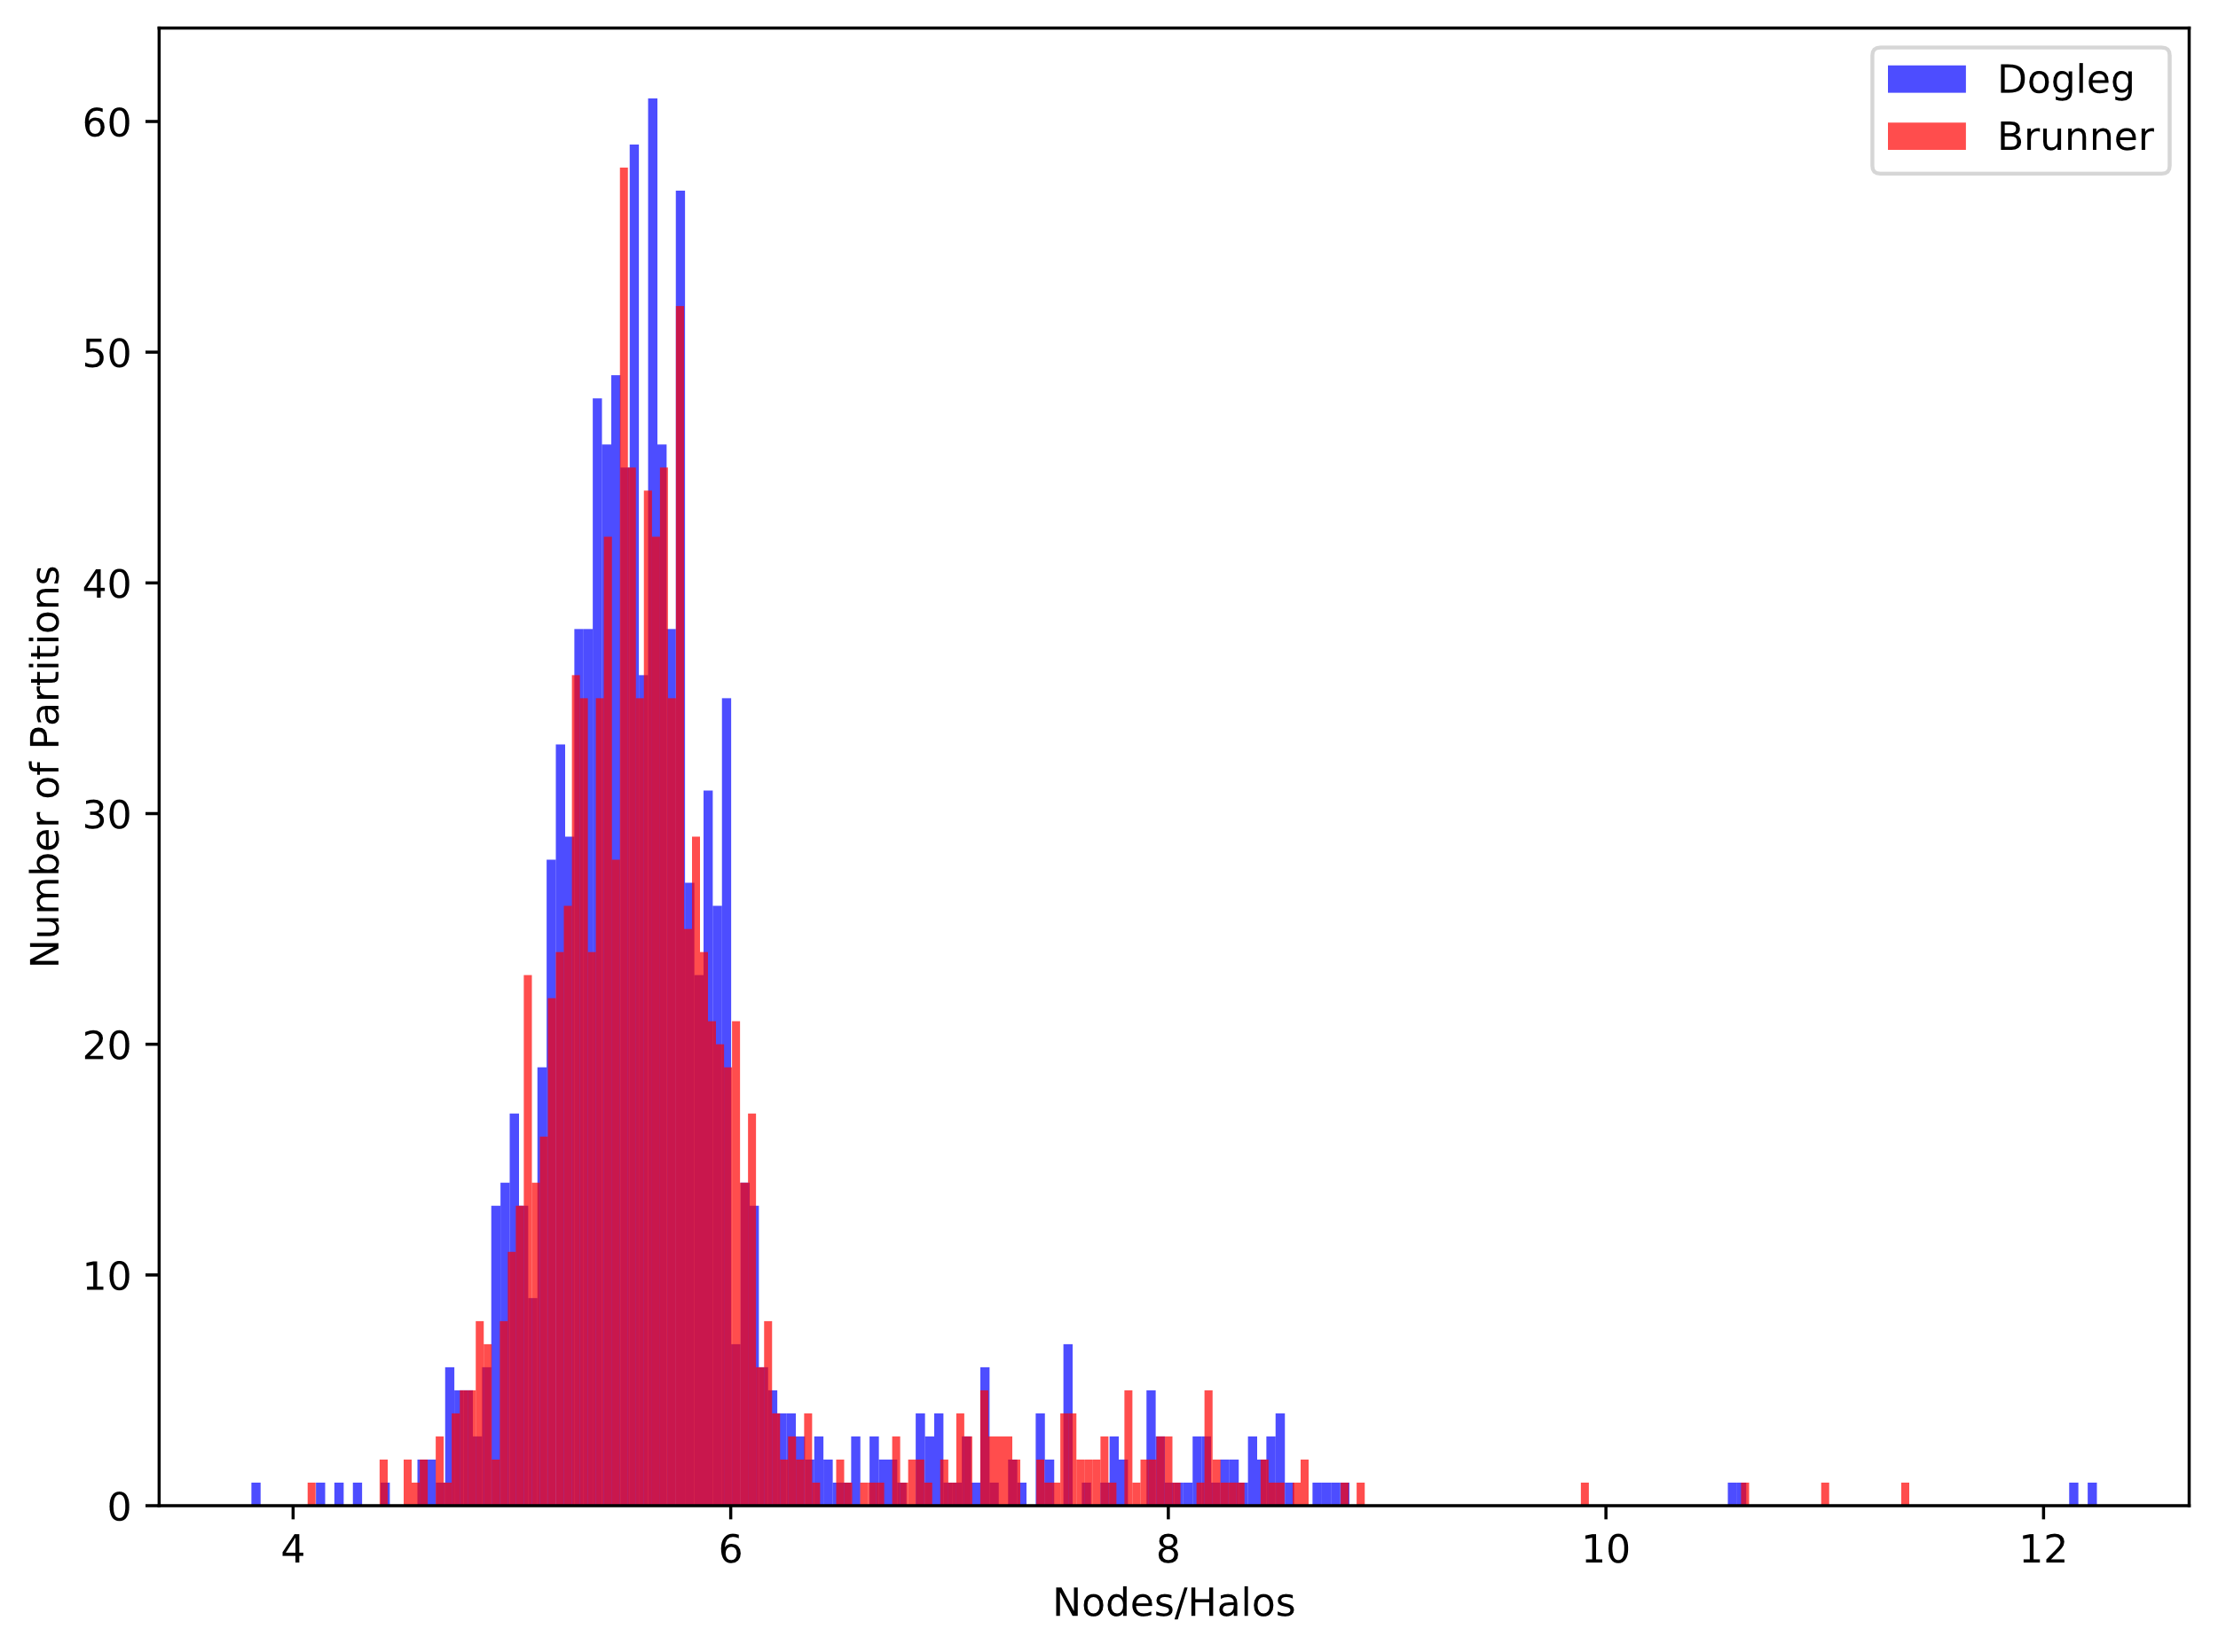
Node-Halo distribution
Notes:
Distributions have 2 modes, the main mode (to the left) where the majority of the partitions falls under and a secondary, smaller mode which corresponds to the boundary partitions, which lack halos in some areas and hence have a higher node/halo ratio.
As we adapt the distribution of nodes/halos in partitions becomes more bimodal with the majority of the partitions being redistributed around areas where we adapted.
As a result, the number of partitions surrounding one another increases, hence requiring an increase in the number of halo nodes, which decreases the node/halo ratio making the iterative solves in these partitions less effective.
On the other hand, the secondary mode of the distribution starts accumulating a greater number of nodes

Slide 18
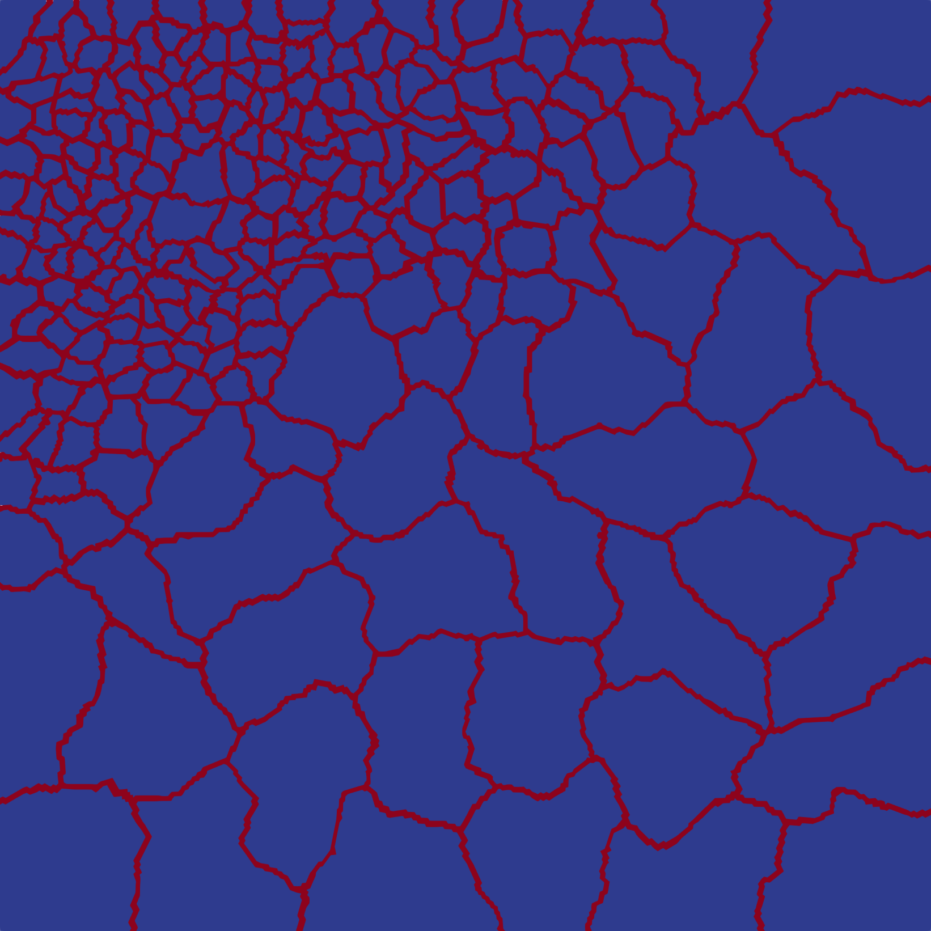
Node/Halo distribution
Notes:
Here you see the distribution of the nodes/halos for 2 different decompositions, the blue (192) strong scaled with 85% efficiency and the red (384) strong scaled with less than 60%.
Both distributions have 2 modes, the main mode (to the left) where the majority of the partitions falls under and a secondary, smaller mode which corresponds to the boundary partitions, which lack halos in some areas and hence have a higher node/halo ratio.
As we adapt the distribution of nodes/halos in partitions becomes more bimodal with the majority of the partitions being redistributed around areas where we adapted.
As a result, the number of partitions surrounding one another increases, hence requiring an increase in the number of halo nodes, which decreases the node/halo ratio making the iterative solves in these partitions less effective.
On the other hand, the secondary mode of the distribution starts accumulating a greater number of nodes
TODO: change the figure for 10: We cant because reaching adapt 10 and not failing actually means that we don’t have the nasty partitions
TODO: generate slides frames!!!! animation

Slide 19
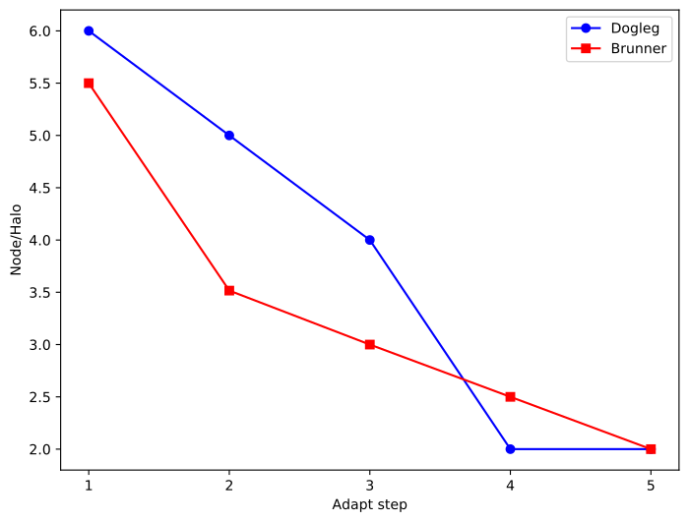
Performance of load balancing algorithm
Main mode of the node-halo ratio distribution as a function of adaptive refinement.
The relative size of the halos increases, implying that the relative communications work is increased for certain partitions.

Slide 20
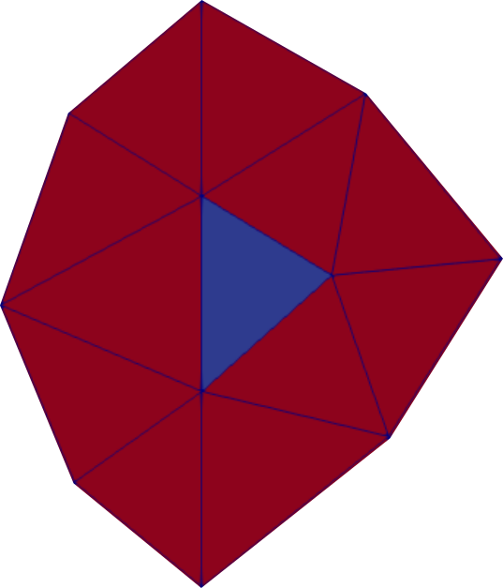
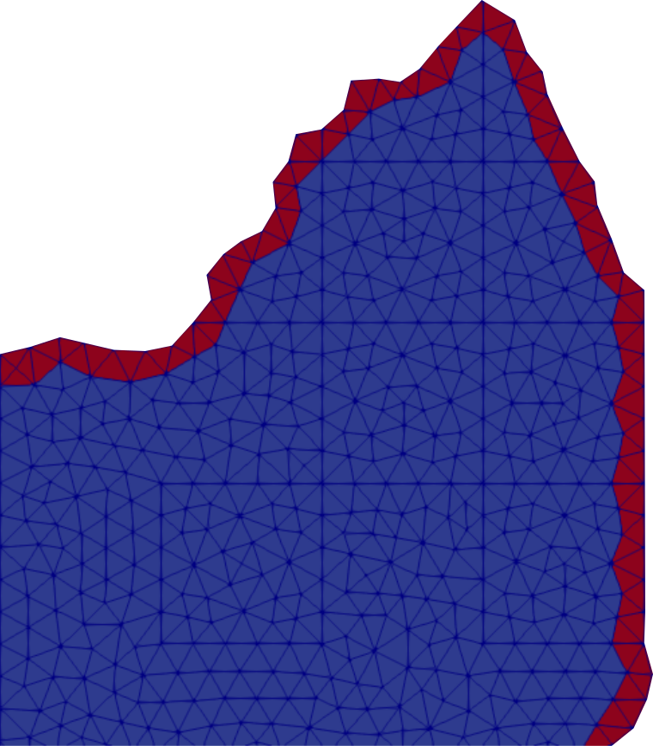
Halo heavy partitions
Notes:
We make sure to minimise the message size sent since the message sizes during a load balance directly affect the performance of the load balancing algorithm
slowdown in matvecs could originate from halos have either too much computational work and/or we do we more comms than we would like
THIS IS THE OPPOSITE TO WHAT HALOS WERE DESIGNED FOR
Not only we do more comms, these comms will look more synchronous,
this is inevitable. Take point from conclusion and then just repeat after

Slide 21
Conclusions
The loss of parallel performance is inevitable for problems with load balancing and angular adaptivity.
The effect is a direct consequence of decomposing the spatial mesh but refining the angular domain, which results in large numbers of small partitions.
Future work will include investigating alternative communication patterns and adding penalty terms to our weight calculations.
Maximising parallel performance with adaptivity is an integral part for developing adaptive algorithms with robust error metrics.
Notes:
TODO: Now that we think we understand!!!!

Slide 22
References
A. Adam, A. G. Buchan, M. D. Piggott, C. C. Pain, J. Hill, and M. A. Gofﬁn. “Adaptive Haar wavelets for the angular discretisation of spectral wave models.” Journal of Computational Physics, volume305, pp. 521–538 (2016). S. Dargaville, A. G. Buchan, R. P. Smedley-Stevenson, P. N. Smith, and C. C. Pain. “Scalable angular adaptivity for Boltzmann transport.” (2019). A. S. Candy. Subgrid scale modelling of transport processes. Ph.D. thesis, Imperial College London (2008). A. Cohen, W. Dahmen, and R. DeVore. “Adaptive Wavelet Techniques in Numerical Simulation.” In Encyclopedia of Computational Mechanics. John Wiley & Sons, Ltd, Chichester, UK (2004). Y. Saad. “A Flexible Inner-Outer Preconditioned GMRES Algorithm.” SIAM Journal on Scientiﬁc Computing, volume14(2), pp. 461–469 (2005). S. Dargaville, A. G. Buchan, R. P. Smedley-Stevenson, P. N. Smith, and C. C. Pain. “Scalable angular adaptivity for Boltzmann transport.” (2019. G. Karypis and V. Kumar. “Multilevel Graph Partitioning Schemes.” [ICPP’95] International Conference on Parallel Processing, volume3, pp. 113–122 (1995). B. Hendrickson and K. Devine. “Dynamic load balancing in computational mechanics.” Computer Methods in Applied Mechanics and Engineering, volume 184(2-4), pp. 485–500 (2000). T. A. Brunner. “Forms of Approximate Radiation Transport.” Technical Report SAND20021778, Sandia National Laboratories, Albuquerque, New Mexico (2002).

Slide 23
Questions

Slide 24
Additional Slides

Slide 25
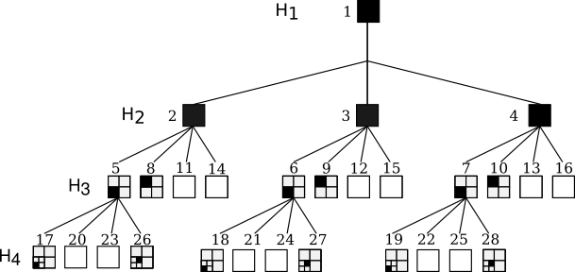
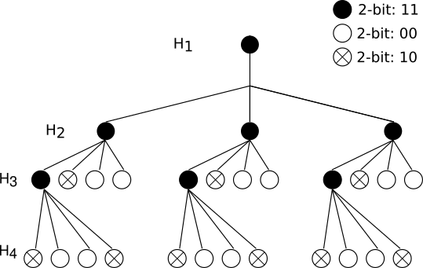
Haar wavelet compression
Compressing the quadtree into a 2-bit representation by iterating through the tree structure. The 2-bit signatures represent directions of the discertisation (angles) that are present with leaves (11), are present but have no leaves (10) or are missing. This compressed the wavelet discretisation by up to x32 and reduced the total message size sent during load balancing by 5 – 7%.
Notes:
We make sure to minimise the message size sent since the message sizes during a load balance directly affect the performance of the load balancing algorithm

Slide 26
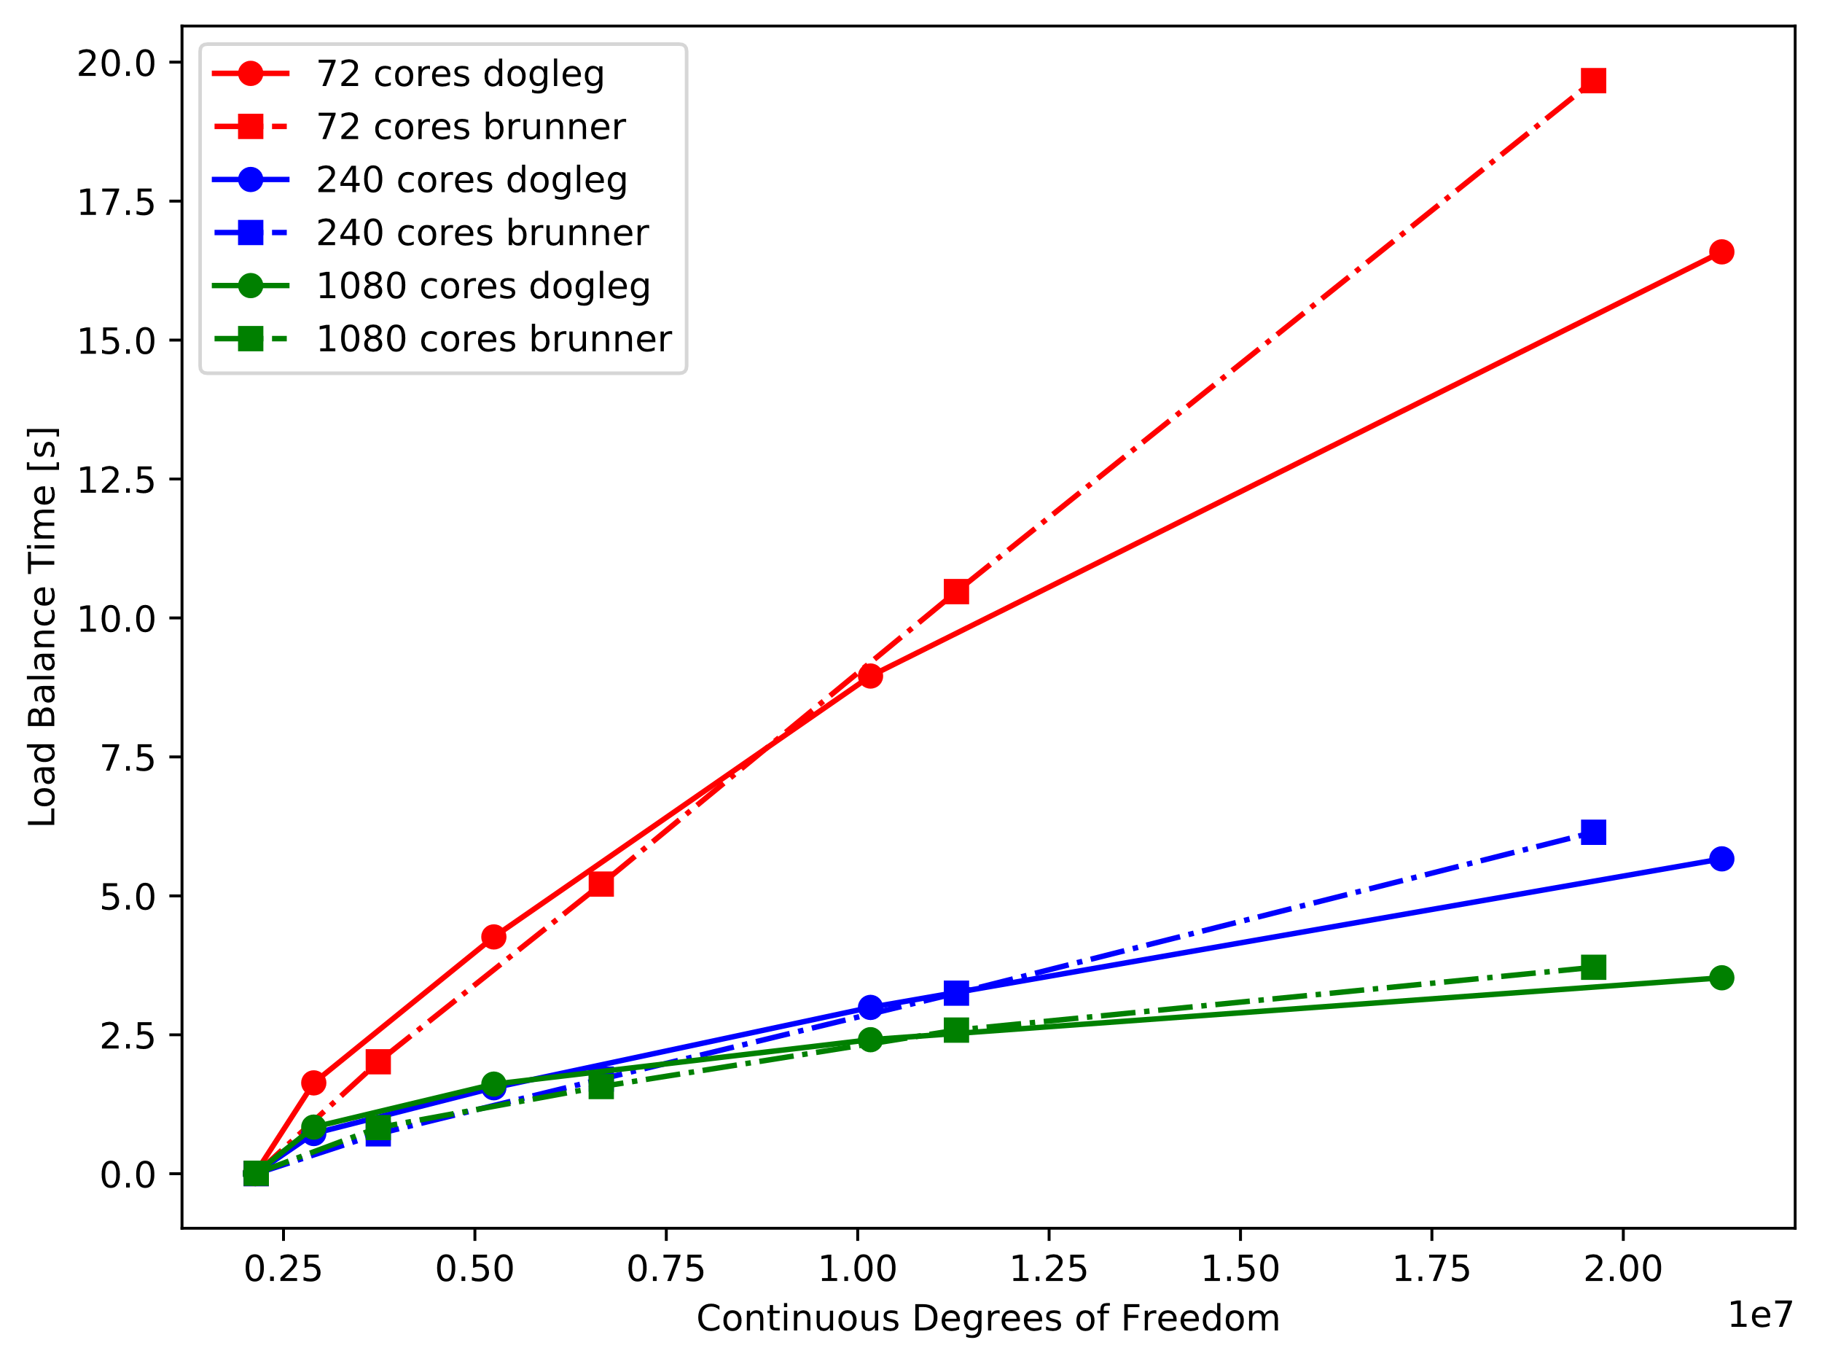
Performance of load balancing algorithm
Notes:
There appears to be an almost linear dependence of the time spent load balancing and the number of unknowns our problem has, especially for larger core counts.
Also, important to note is that as the number of processors increases the time spent load balancing is decreased

Slide 27
Introduction: FETCH2
FETCH2 is a Deterministic Finite Element code developed by AMCG in Imperial College London.
Features include:
Regular & Goal based spatial adaptivity.
Regular & Goal based anisotropic angular adaptivity.
Large-scale parallelism.
Load balancing capabilities with tools like ParMETIS and Zoltan.

Slide 28
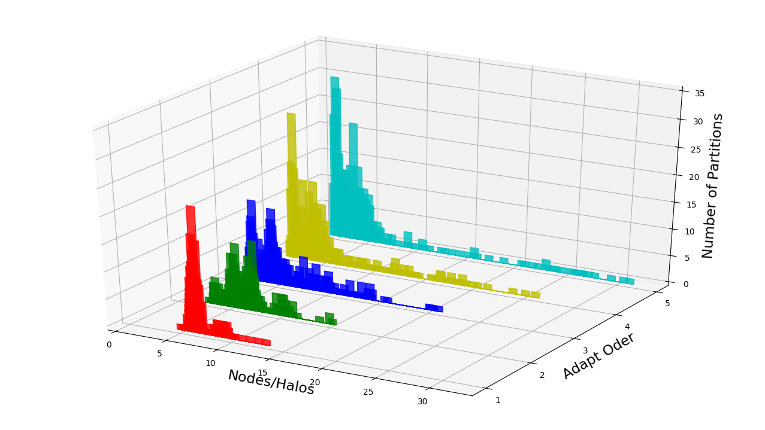

Slide 29
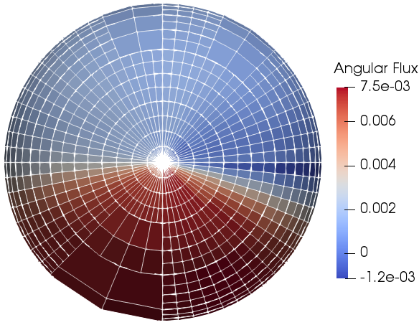
Adaptive Mesh Refinement
Mesh adaptivity allows for localised refinement and de-refinement.
Shielding problems are highly dependent on the directional part of radiation, described by an angular mesh.
We used a non-standard Haar wavelets decomposition for the angular mesh, with the azimuthal and polar angles being equal within the element.

Slide 30
Importance of load balancing
The load balancing algorithm decomposes the spatial mesh.
However, the imbalances in work exist in the angular mesh and not in the spatial.
The mismatch between the decomposed mesh and the imbalanced mesh creates complications to parallel performance as seen later on.
Notes:
DLB operation:
The Load balancing algorithm ParMETIS works by assigning weights to each spatial node.
We take the ratio of the angular expansion (which is the number of unknowns in the angular dimension) at that node divided by the greatest angular expansion of the entire spatial mesh.
This calculation is performed for every node in the entire mesh.
The node which yields the largest ratio specifies the load imbalance of the entire problem.
Then the algorithm compares the load imbalance of the mesh with a user defined imbalance threshold.
If the load imbalance is bigger than the threshold then a load balance occurs and the entire mesh is repartitioned.
Load balances are performed before the start of the iterative method to minimise the imbalances introduced from the refinement process.
For our testing we ensure that a load balance will occur before every solve by providing a very small threshold value.

Slide 31

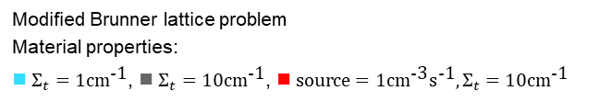
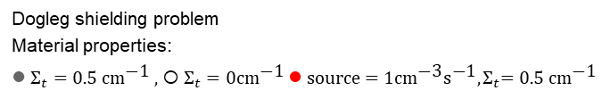
Brunner lattice
Modified Brunner lattice problem
Material properties:
■ $Σ_{t}=1{\text{cm}}^{\text{−1}}$,  $Σ_{t}=10{\text{cm}}^{\text{−}\text{1}}$,  ${\text{source}=1{\text{cm}}^{\text{−3}}{\text{s}}^{\text{−1}}, Σ}_{t}=10{\text{cm}}^{\text{−}\text{1}}$
Dogleg shielding problem
Material properties:
● $Σ_{t}=0.5 {\text{cm}}^{\text{−}\text{1}} ,$ ○ $Σ_{t}=0{\text{cm}}^{\text{−}\text{1}}$${ \text{source}=1{\text{cm}}^{\text{−}\text{3}}{\text{s}}^{\text{−}\text{1}}, Σ}_{t}=0.5 {\text{cm}}^{\text{−}\text{1}}$
Notes:
The problem consists of a source (red), a transparent medium (white) and an absorber (grey) with their respective total cross sections being 0.5, 0.005 and 0.5 cm⁻¹ and the source also having a fission cross section of 1 cm⁻³s⁻¹.
This problem features highly anisotropic flux and heavy particle streaming through the duct regions.
The problem was simulated by using a mesh with 500k triangular elements and 1.1M CDOFs at adapt 0

Slide 32
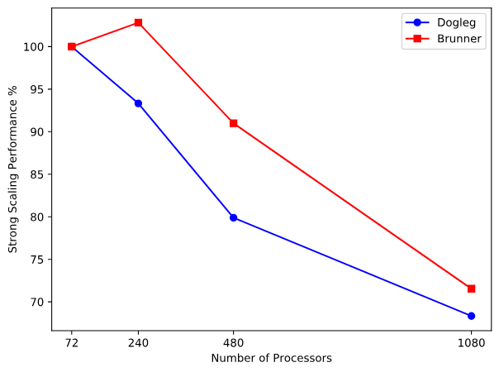
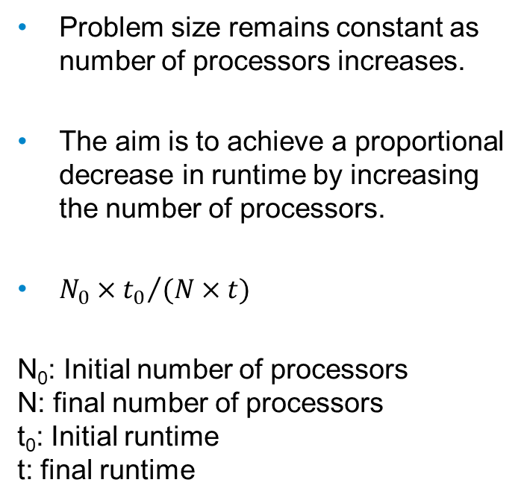
Strong scaling study
Problem size remains constant as number of processors increases.
The aim is to achieve a proportional decrease in runtime by increasing the number of processors.
${{N_{0}×t}_{0}}/{(N×t)}$
N₀: Initial number of processors N: final number of processors t₀: Initial runtime t: final runtime
Notes:
TODO: remove this slide!!!!!!

